Slide 1


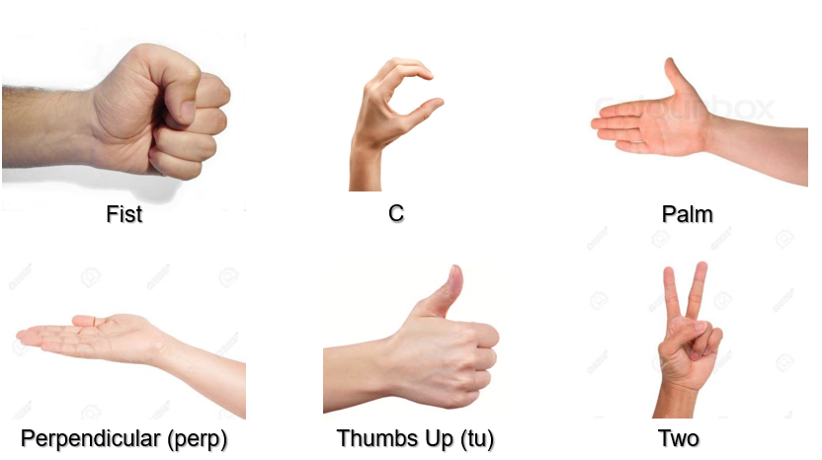
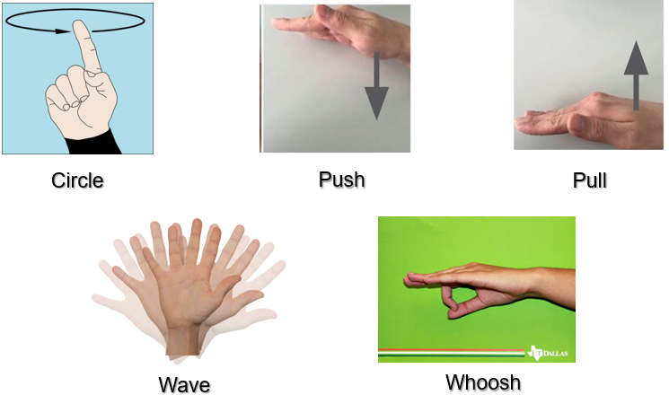
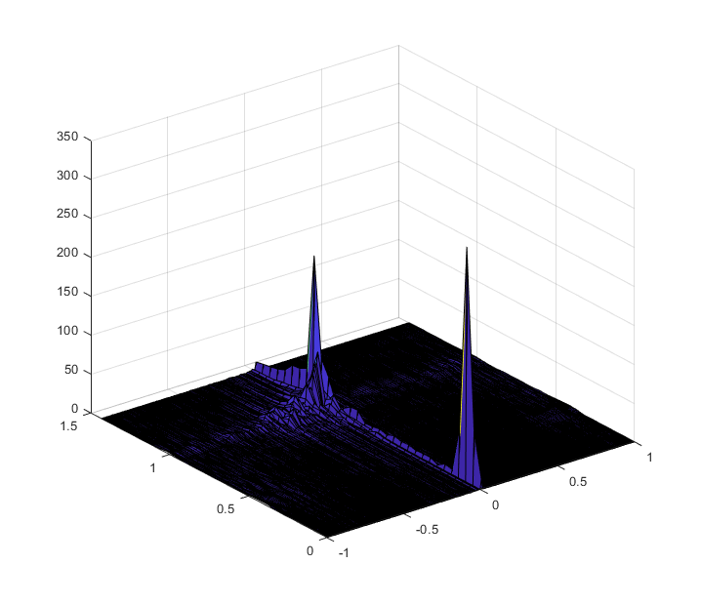
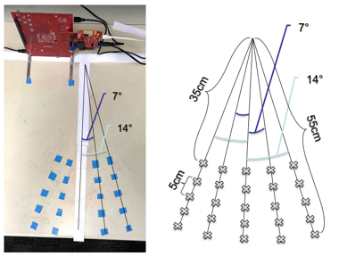

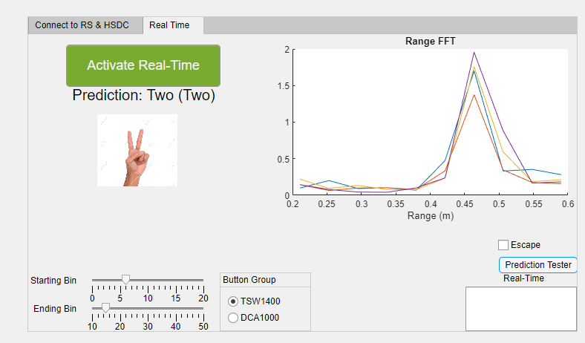
Real-Time Deep Learning Gesture Classification Models on mmWave Radar
J. Smith, S. Thiagarajan, R. Willis, G. Balagopal, M. Torlak, Y. Makris
The University of Texas at Dallas, 800 W. Campbell Rd. Richardson, TX 75080
Motivation
Background
Ability of mmWave radar technology to capture depth/velocity information of non-line-of-sight targets makes radar imaging promising alternative to optical cameras in many applications such as 3D gesture/pattern recognition, motion tracking, contour tracing, etc.
Hand gesture recognition is an integral part of wireless human-computer interaction. MIMO mmWave radar allows for precise estimation of the depth and velocity of targets while providing some additional azimuth information.
Six static hand gestures and five dynamic hand gestures were collected.
Various orientations and rotations are considered for each gesture.
mmWave Radar Specifications:
Using 3 Tx and 4 Rx antennas along with a 4GHz bandwidth from 77-81GHz, the sensor will capture 12 channels of depth and cross-range information with a wavelength of ~4mm.
Static: 1 frame, 512 range samples
Dynamic: 256 frames captured over 1.28s, 64 range samples
Objective
Develop CNN deep learning-based algorithms for recognizing hand gestures from depth, azimuth, and velocity information provided by mmWave radar.
Set up a MATLAB-based real-time platform for gesture recognition.
Observed Range-Doppler Spectrum
Proposed Methodology
Hand Gesture
mmWave Radar
Range Analysis
Doppler and Azimuth Preprocessing
Estimate Class Densities
Deep Learning CNN w/ KDE
Real-time Prediction
Leverage TI mmWave radar AWR1443 to collect large radar image datasets for each gesture class.
Perform initial range analysis on gesture data.
Preprocess to extract doppler velocity and azimuth cross-range information to enhance feature space of data prior to deep learning feature extraction.
Conduct kernel density estimation to approximate the probability density functions of multidimensional gesture data.
Develop highly accurate CNN architectures for gesture classification.
Use estimated density functions for each class to artificially enrich data pool and retrain CNNs.
Deploy a MATLAB-based platform for real-time gesture recognition using the pre-trained deep learning models.
Results
Summary
Dynamic | Without KDE |  | With KDE
 | Train | Test | Train | Test
Baseline | 100 | 98.8 | 100 | 100
RA 2D | 93.1 | 90.2 | - | -
RA 3D | 100 | 100 | 100 | 100
LDS 3D | 100 | 100 | 100 | 100
Highly accurate CNN-based deep learning models allow for ~90% classification accuracies of static gestures, ~98% accuracies of dynamic gestures.
Using kernel density estimation to enhance the data pool, static and dynamic gesture classifications can reach ~97% and ~100% accuracies, respectively.
Real-time classification platform developed in MATLAB and deployed successfully.
This progress highlights the potential of deep learning-based gesture and pattern recognition using radar imaging.
Fig. 1
Fig. 3
Future Work
Static | Without KDE |  | With KDE
 | Train | Test | Train | Test
Small Dataset | 99.6 | 94.6 | 100 | 97.3
SV Dataset | 90.8 | 86.2 | 100 | 92.3
SV RA2D | 96.3 | 91.0 | - | -
SV RA3D | 97.9 | 92.6 | 99.9 | 96.8
MATLAB application implementing pre-trained deep learning networks for real-time static and dynamic gesture classification (Fig. 1).
Static gesture classification improvement over different datasets using various range-angle processing techniques and CNN input sizes for both raw and KDE enriched data (Fig. 2).
Prediction accuracy of the dynamic gesture datasets with and without KDE (Fig. 3). For both static and dynamic cases, leveraging 3D angle information improves classification accuracies.
Incorporate more data representing unknown data ‘corners’ of the gestures to improve the accuracy of the prediction algorithms.
Develop asynchronous dynamic gesture input model for real-time human-computer interaction without the need for cumbersome cables and interface devices.
Acknowledgments
Fig. 2
This work is supported by Texas Instruments through Foundational Technology Research Centre (FTRC).

